Slide 1


A Murder Mystery Game
The Ulimate Test of Foodie Fun Facts
SICI4037: Data Communications
Gabriel E. Rodríguez García
Claudia P. Monge Torres
Christian J. Ramos Ortega

Slide 2
what IS "CLUE"?
Clue is a murder mystery game where the objective is to determine who murdered the game's victim, where the crime took place, and which weapon was used. Each player assumes the role of one of the six suspects and attempts to deduce the correct answer by strategically moving around a game board representing the rooms of a mansion and collecting clues about the circumstances of the murder from the other players.

Slide 3
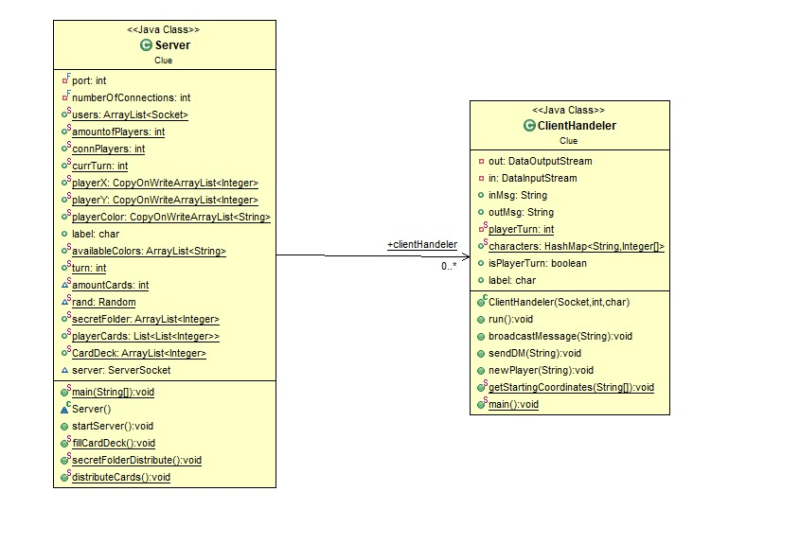
DESIGN OF THE SYSTEM: SERVER

Slide 4
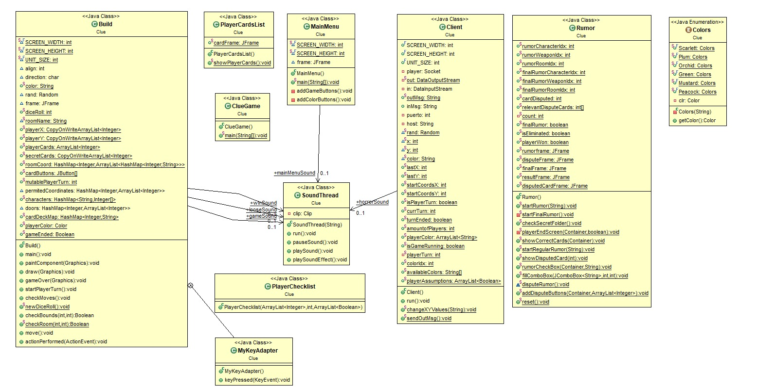
DESIGN OF THE SYSTEM: CLIENT

Slide 5
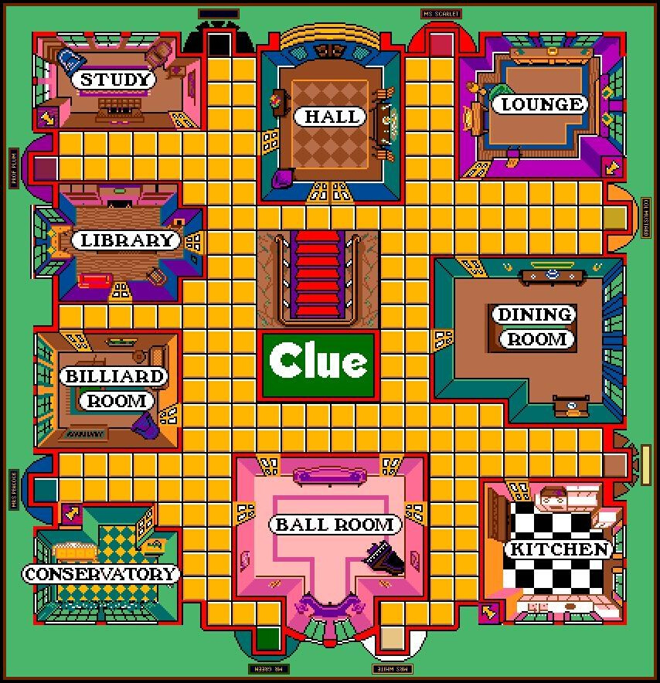
Game mechanics
Navigate through the board.
Enter rooms to create accusations (rumors).
Dispute accusations.
Notetaking.

Slide 6

↓for down
C for Checklist
GAME CONTROLS
P For Cards
← for left
Press the following keys while playing!
↑ for up
→ for Right
MOuse to choose cards, and fill checklist

Slide 7
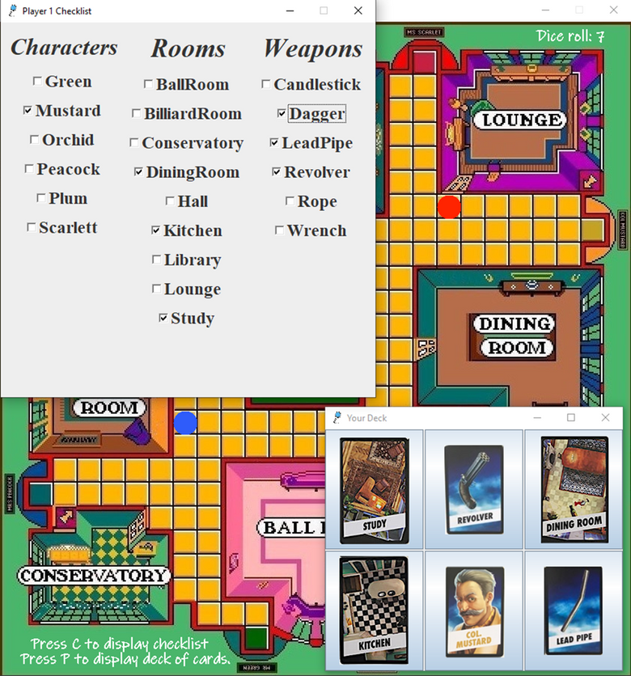
DATA COMMUNICATION
The communication established with the server will retrieve all the necessary data the player needs before starting the game:
Turn assigned to player.
list of player's cards.
The color picked by the player.
Starting position assigned to color.
But also, the data needed throughout the game:
If it's the player's turn.
The player's coordinates
If a rumor started
The card the player disputes.
If the player was eliminated.

Slide 8
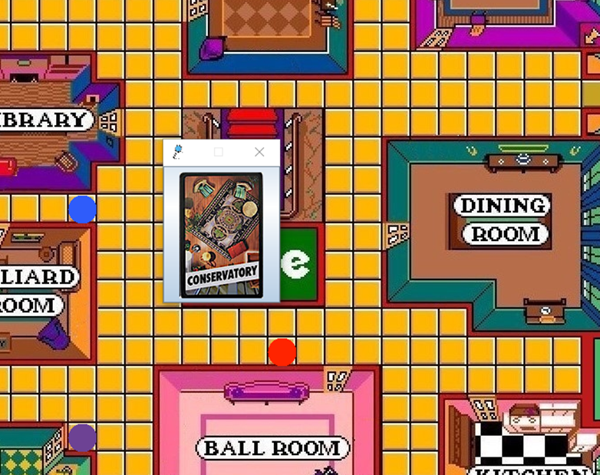
DATA COMMUNICATION
As the players connect to the server, they will be assigned their own individual in, out, turn, and label for identification purposes.
Thread works is in a zig-zag pattern where the client handler, sends the first message, the client receives it and sends in a response.
Communication works like a group chat, where everyone receives 'my message' but there is no need for me to receive my own message again.

Slide 9
Optimize the amount of windows.
Increase interaction between players.
Go over complete rounds
to dispute a rumor.
Develop secret tunnels!
future work

Slide 10
REFERENCES
[WittCode]. (2021, August 16). Java Socket Programming - Multiple Clients Chat
[Video]. YouTube. https://www.youtube.com/watch?v=gLfuZrrfKes
Microchip Developer Help. (n.d.). Retrieved from https://microchipdeveloper.com/tcpip:client-server-programming-model
Oracle: Sockets Communication. (n.d.). Retrieved from https://www.oracle.com/java/technologies/jpl2-socket-communication.html
Socket.io. (n.d.). Retrieved from https://socket.io/docs/v4/emit-cheatsheet

Slide 11
DEMO

